Slide 1
Machine learning
Regent College London
SWE6204

Slide 2
Machine learning
SWE6204

Slide 3

Machine learning
Introduction to Data Science

Slide 4
Module 1 – Introduction to Data Science

Slide 5
Learning objectives
Understand the type of data
Understand the Mean, Medium & Mode
Understand basic data science techniques

Slide 6
Type of data
Numerical
Categorical
Ordinal

Slide 7
Numerical
Represents some sort of quantitative measurement
Heights of people, page load times, stock prices, etc.
Discrete Data
Integer based; of ten counts of some event.
How many purchases did a customer make in a year? How many times did I flip “heads”?
Continuous Data
Has an infinite number of possible values
How much time did it take for a user to check out? How much rain fell on a given day?

Slide 8
Categorical
Qualitative data that has no inherent mathematical meaning
Gender, Yes/no (binary data), Race, State of Residence, Product Category, Political Party, etc.
You can assign numbers to categories in order to represent them more compactly, but the numbers don’t have mathematical meaning

Slide 9

ordinal
A mixture of numerical and categorical
Categorical data that has mathematical meaning
Example: movie ratings on a 1-5 scale.
Ratings must be 1, 2, 3, 4, or 5
But these values have mathematical meaning; 1 means it’s a worse movie than a 2.

Slide 10
mean
AKA Average
Sum / number of samples
Example:
Number of children in each house on my street: 0, 2, 3, 2, 1, 0, 0, 2, 0
The MEAN is (0+2+3+2+1+0+0+2+0) / 9 = 1.11

Slide 11
Median
Sort the values, and take the value at the midpoint.
Example:
    0, 2, 4, 2, 1, 0, 0, 2, 0 Sort it:
    0, 0, 0, 0, 1, 2, 2, 2, 4

Slide 12
median
If you have an even number of samples, take the average of the two in the middle.
Median is less susceptible to outliers than the mean
Example: mean household income in the US is $72,891, but the median is only $51,234 – because the mean is skewed by a handful of billionaires.

Slide 13
Mode
The most common value in a data set
Not relevant to continuous numerical data
Back to our number of kids in each house example:
0, 2, 3, 2, 1, 0, 0, 2, 0,0
How many of each value are there?
0: 5, 1: 1, 2: 3, 3: 1
The MODE is 0

Slide 14
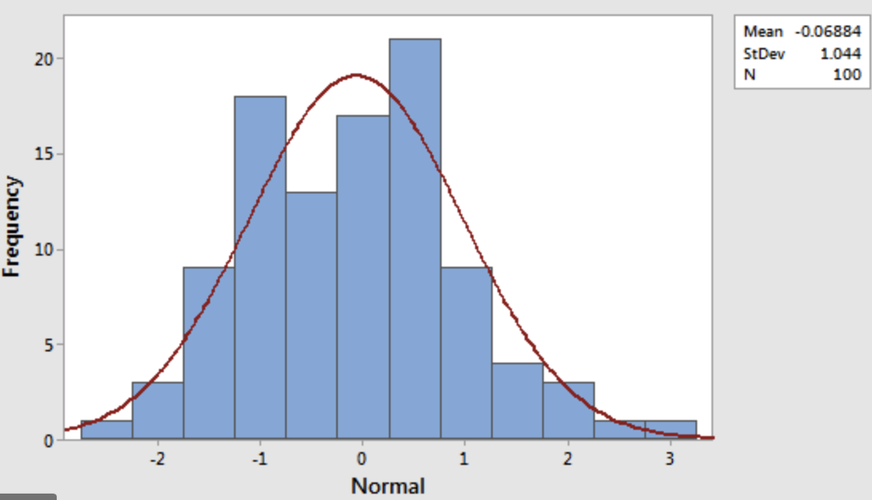
Histogram-normal distribution

Slide 15
variance
Variance measures how “spread-out” the data is.
Variance (𝜎2) is simply the average of the squared differences from the mean
Example: What is the variance of the data set (1, 4, 5, 4, 8)?
First find the mean: (1+4+5+4+8)/5 = 4.4
Now find the differences from the mean: (-3.4, -0.4, 0.6, -0.4, 3.6) Find the squared differences: (11.56, 0.16, 0.36, 0.16, 12.96)
Find the average of the squared differences:
𝜎²= (11.56 + 0.16 + 0.36 + 0.16 + 12.96) / 5 = 5.04

Slide 16
Standard deviation
𝜎² = 5.04
𝜎 = Sq(5.04) = 2.24
This is usually used as a way to identify outliers. Data points that lie more than one standard deviation from the mean can be considered unusual.
You can talk about how extreme a data point is by talking about “how many sigmas” away from the mean it is.

Slide 17
Population vs sample
If you’re working with a sample of data instead of an entire data set (the entire population)...
Then you want to use the “sample variance” instead of the “population variance”
For N samples, you just divide the squared variances by N-1 instead of N.
So, in our example, we computed the population variance like this:
𝜎2= (11.56 + 0.16 + 0.36 + 0.16 + 12.96) / 5 = 5.04 ▫
But the sample variance would be:
𝑆2= (11.56 + 0.16 + 0.36 + 0.16 + 12.96) / 4 = 6.3

Slide 18
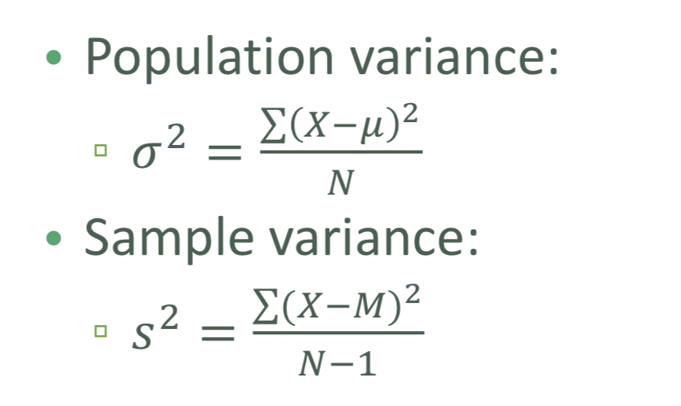
Population vs sample

Slide 19
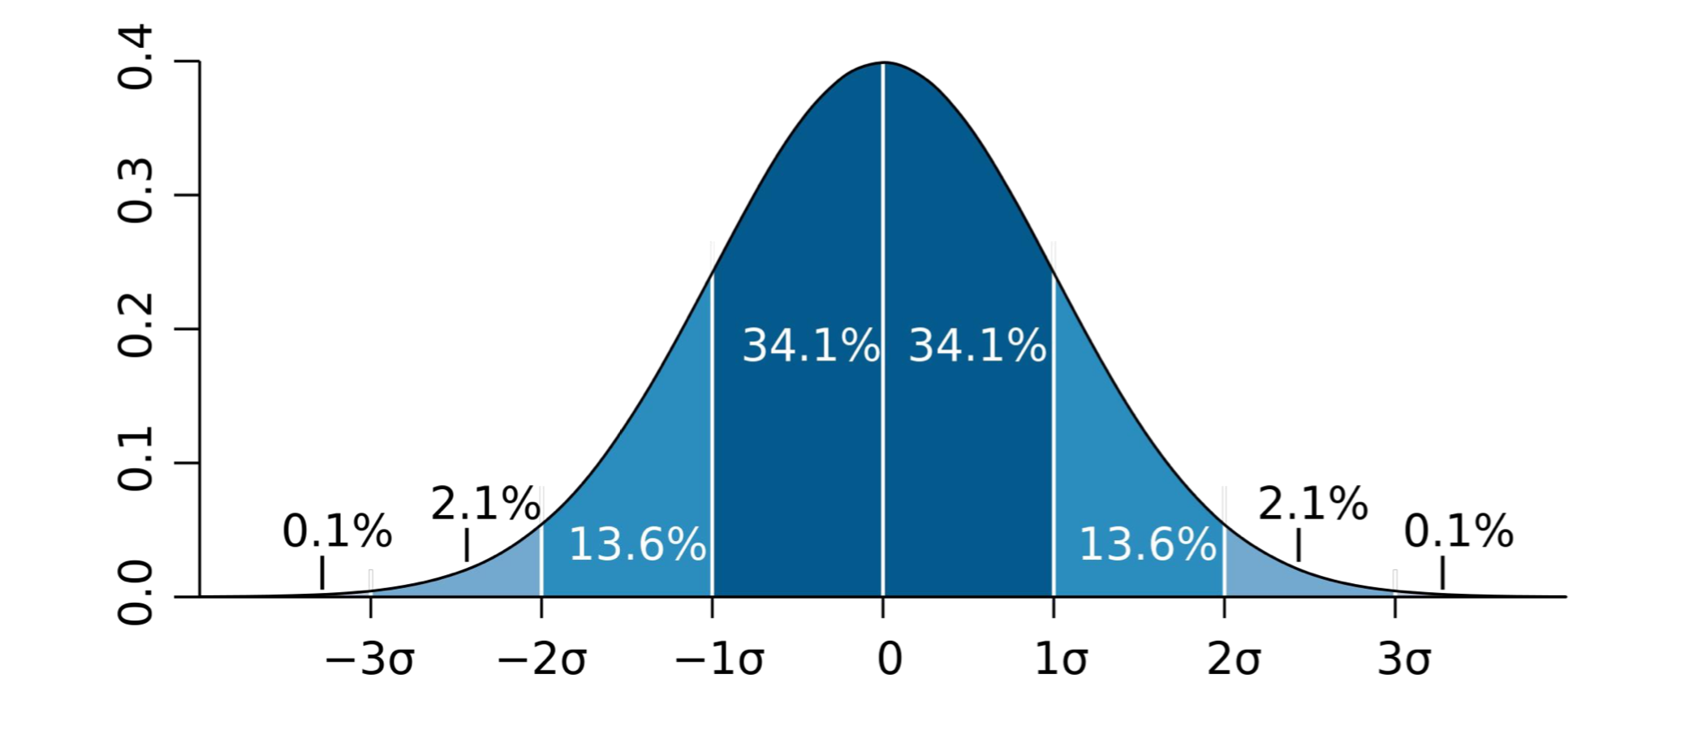
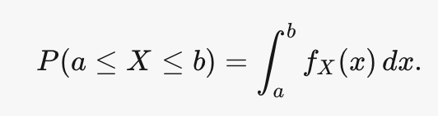
Probability density function
The probability that a random variable X takes a value in the (open or closed) interval [a,b] is given by the integral of a function called the probability density function f_{x}(x) :
Gives you the probability of a data point falling within some given range of a given value.

Slide 20
percentile
A percentile (or a centile) is a measure used in statistics indicating the value below which a given percentage of observations in a group of observations fall.
For example, the 20th percentile is the value (or score) below which 20% of the observations may be found.

Slide 21
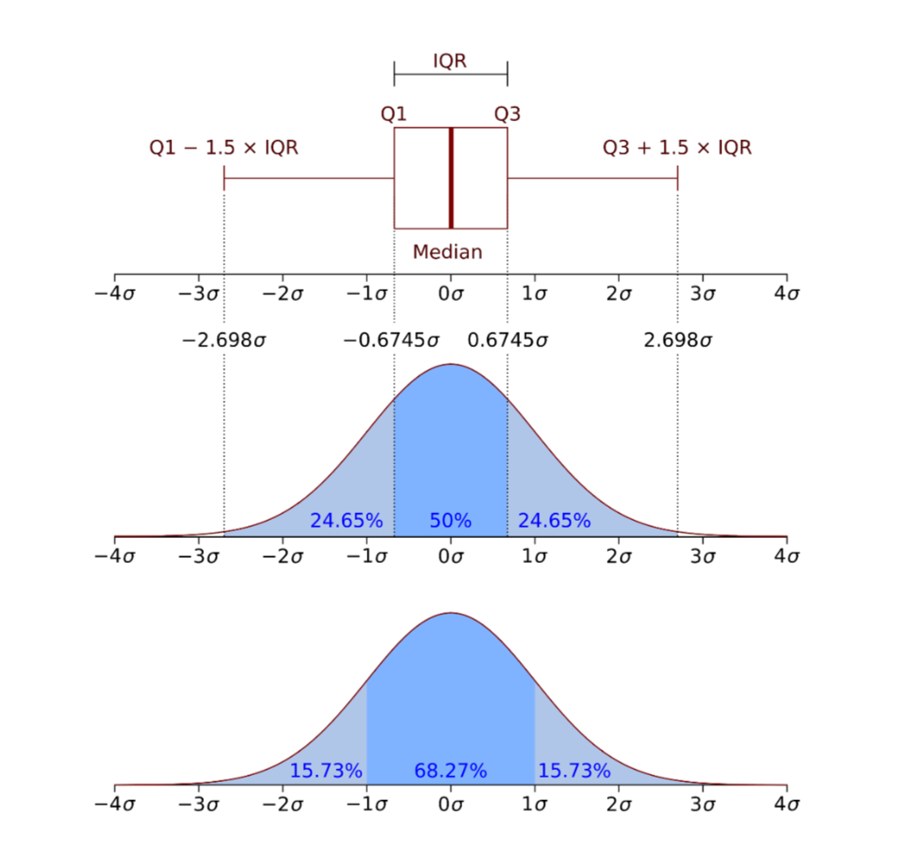
Percentile in a normal distribution

Slide 22
moments
Quantitative measures of the shape of a probability density function
Mathematically they are a bit hard to wrap your head around:
But intuitively, it’s a lot simpler in statistics.
The first moment is the mean.
The second moment is the variance.

Slide 23
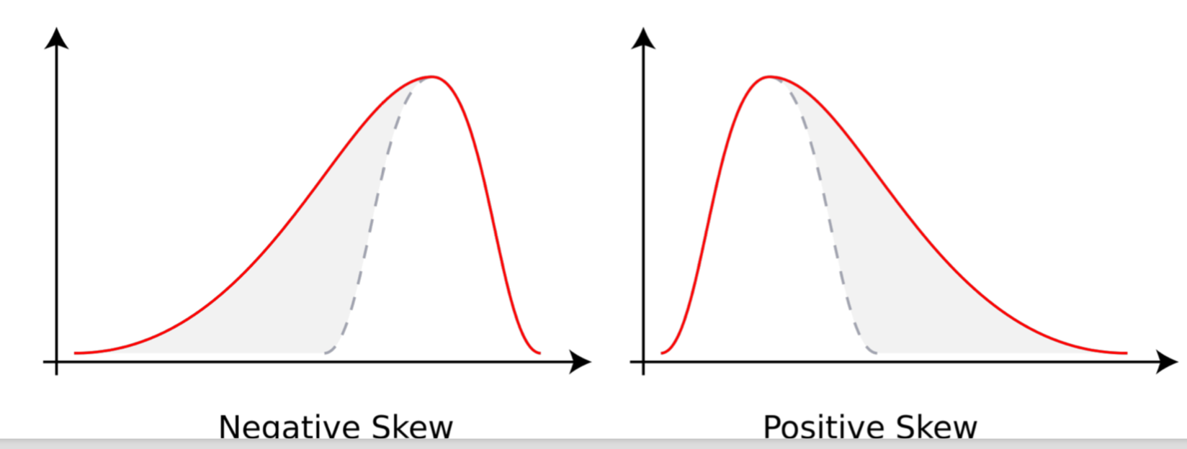
Third Moment
How “lopsided” is the distribution?
A distribution with a longer tail on the left will be skewed left, and have a negative skew.

Slide 24
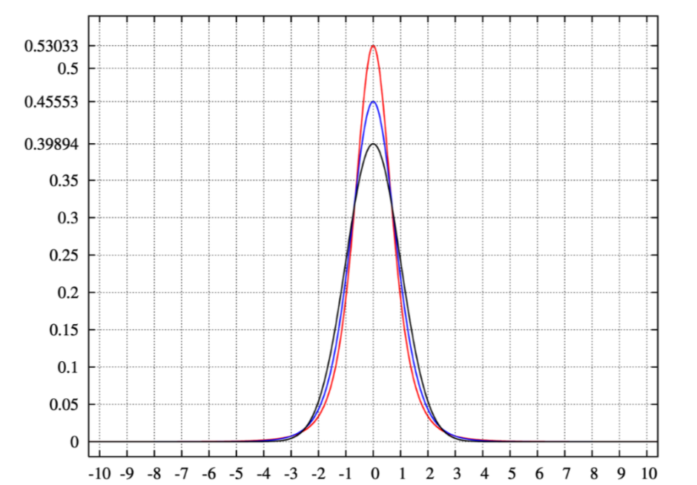
Fourth moment
The fourth moment is “kurtosis”
How thick is the tail, and how sharp is the peak, compared to a normal distribution?
Example:
higher peaks have higher kurtosis

Slide 25
Correlation
Correlation is a term that is a measure of the strength of a linear relationship between two quantitative variables (e.g., height, weight).
Correlation of -1 means a perfect inverse correlation
Correlation of 0: no correlation
Correlation 1: perfect correlation

Slide 26
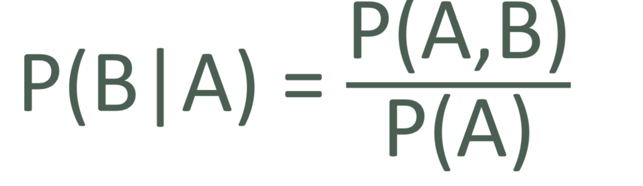
Conditional probabilty
If I have two events that depend on each other, what’s the probability that both will occur?
Notation: P(A,B) is the probability of A and B both occurring • P(B|A) : Probability of B given that A has occurred
We know:

Slide 27
example
I give my students two tests. 60% of my students passed both tests, but the first test was easier – 80% passed that one. What percentage of students who passed the first test also passed the second?
A = passing the first test, B = passing the second test
So we are asking for P(B|A) – the probability of B given A
P(B|A) = P(A,B) = 0.6 = 0.75
P(A) 0.8
75% of students who passed the first test passed the second.

Slide 28
+44 (0)207 016 8000
info@rcl.ac.uk

